Slide 1
Objects, Loops, & Review Lab
Front-End Web Development

Slide 2
Lesson 16 Change Log FEWD 3.1 - 3.2
Below are the specific changes made in this lesson.
Returning Instructor Directions:
Click on the hyperlinks below, and it will direct you to the specific slide.
Copy the entire slide, and paste in your existing curriculum deck.
Pre-Class Materials and Preparation - Since this lesson no longer focuses on API, check out the Flex collection if you want to continue incorporating API-related activities.
Added the following CodePens to the new CodePen collection “Warmups”: Forms Warmup, Final Review Lab User Behavior Demo, Starter, Solution, To-Dos Only Solution, Solution with Local Storage, and Solution with Event Delegation.
Build a To-Do App (whole section) - Added a new review lab and moved API to flex.
Final Project Checkpoint - Added a discussion about final projects, including teaching tips and suggestions for customization.
Share how the lesson went through our Instructor Lesson Exit Ticket - the Curriculum Feedback form: http://ga.co/curriculum-feedback

Slide 3
Pre-Class Materials and Preparation
Review all slides, lab activities, and code-alongs.
There are prompts in the speaker notes with opportunities for instructor customization.
Materials:
Flex in CodePen
Warmups in CodePen

Slide 4
Final Review Lab
Overview
This lesson reviews the course content so far, allowing time for students to solidify the knowledge they've gained and ask necessary questions before moving further.
Learning Objectives
In this lesson, students will:
Apply CSS and JS skills to fit requirements of an assigned project.
Duration: 180 minutes

Slide 5
Suggested Agenda
Time | Activity | Purpose
0:00–0:30 | Q&A Review of JS So Far | There will likely be questions and a need for a review before jumping in to the review lab.
0:30–3:00 | Final Review Lab | Cumulative challenge bringing together all the concepts from the course to this point.

Slide 6
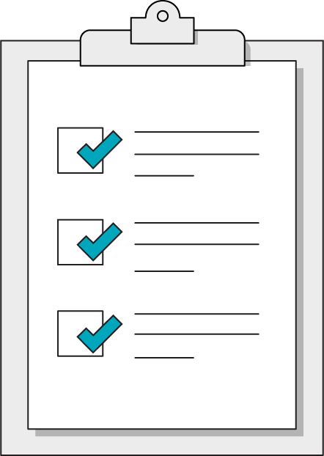
Today’s Learning Objectives
In this lesson, you will:
Apply CSS and JS skills to fit requirements of an assigned project.
‹#› | © 2020 General Assembly
Notes:
DURATION: 1 minute
TEACHING TIPS:
Learning objectives help frame the lesson and give students an idea of what to expect and focus on.
Explain to students how this lesson fits into the overall course to help them make connections with content from other lessons.

Slide 7
Objects
Front-End Web Development

Slide 8
Objects
Objects are another type of data in JavaScript. Like arrays they hold multiple pieces of data. Unlike arrays, they use properties instead of keys AND the properties are in no particular order.
let myObject = { ‘fruits’ : [ ‘orange’ , ’apple’ ], ‘veggies’ : [ ‘celery’ , ’carrow’ ] }

Slide 9
Syntax
const produce = {‘fruits’:["banana", "orange", "apple"]}
You make an array using a set of curly brackets.
Inside the brackets, each value must have a property name and value delimited by a colon and separated by a comma.
Object can contain, strings, numbers, booleans, functions, other objects or any of these combined.
Notes:
TALKING POINTS:
Although the example above is three strings, it’s possible to store data of any type in any array — even more arrays! It can also be tricky at first to understand that const doesn’t prevent us from changing the stuff inside the array. We just can’t re-assign the variable to a new value.

Slide 10
Petfinder
Front-End Web Development

Slide 11
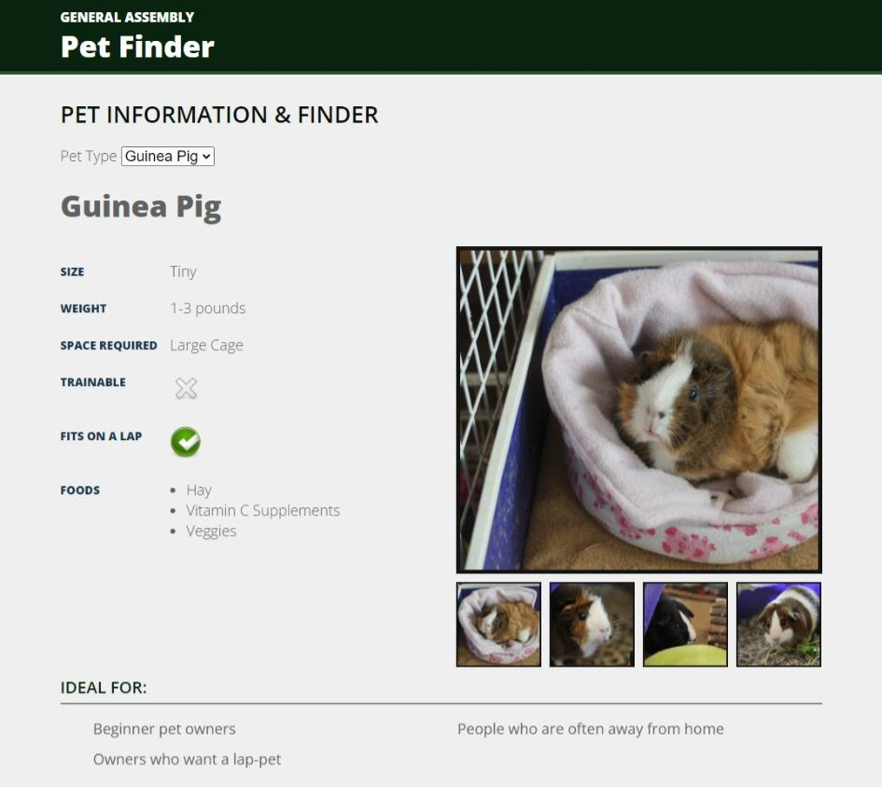
Pet Finder
120 minutes
Today, you’re going to build a page to help users learn about potential pets. To build this page:
Figure out what type of pet has been selected
Loop through all the types of information for that pet type
Output it on the DOM
Note: some types of information may need be transformed from what is in the object.

Slide 12
Pet Finder
Loop through each selected part of the object to create the pet information!
Starter code:
https://drive.google.com/drive/folders/1ECuJBSbGJDlRk5cn1RxwcSR1n4kZSm7-?usp=sharing
Solution code:
https://drive.google.com/drive/folders/1zvil6ku62JpevHjVCCfiThFmWpTvFqv5?usp=sharing

Slide 13
Pet Finder: Encrichment - Ajax
In the previous exercise, we loaded the data from a statically defined object. Instead let’s load it on the fly using ajax!
Solution code:
https://drive.google.com/drive/folders/1Si9WDfKV_iaQ16ga87o0Bx7Lf3Zmo8P2?usp=sharing

